Slide 1
Determinants of Automobile Paid Losses
By Caspar Chen, Raja Fara Athirah Raja Hamzah, & Zhanyang (Jenna) Shen,

Slide 2
Research Question
Do physical characteristics of automobiles affect the amount of paid losses by insurer when automobiles involved in collision?

Slide 3
Motivation
In the second half of 2013, personal automobile insurers noticed an uptick in auto collision losses
Collision coverage constitutes 26% auto insurance premium
Rating factors : demographic factors, driving habits, type of policy
Interested in exploring if physical characteristics of an automobile can be good rating factors for automobile insurance
Notes:
http://www.casact.org/cms/files/AutoLossCost1Q_20180130_1.pdf
https://www.iii.org/sites/default/files/docs/pdf/auto_rates_wp_092716-62.pdf
https://www.allstate.com/tools-and-resources/car-insurance/factors-affect-your-auto-insurance.aspx

Slide 4
Literature Review
Insurance company are recommended to consider auto burden index into the traditional rate making model (Duan, 2018).
Normalized losses is not directly related to the features or characteristics of a car with Factor Analysis (Xiao & Yu, n.d.)
Low- and medium-income drivers are charged higher premiums, a common pricing practices among major carriers (Heller & Styczyski, 2016)
Notes:
a method of classifying rates into different risk factors

Slide 5
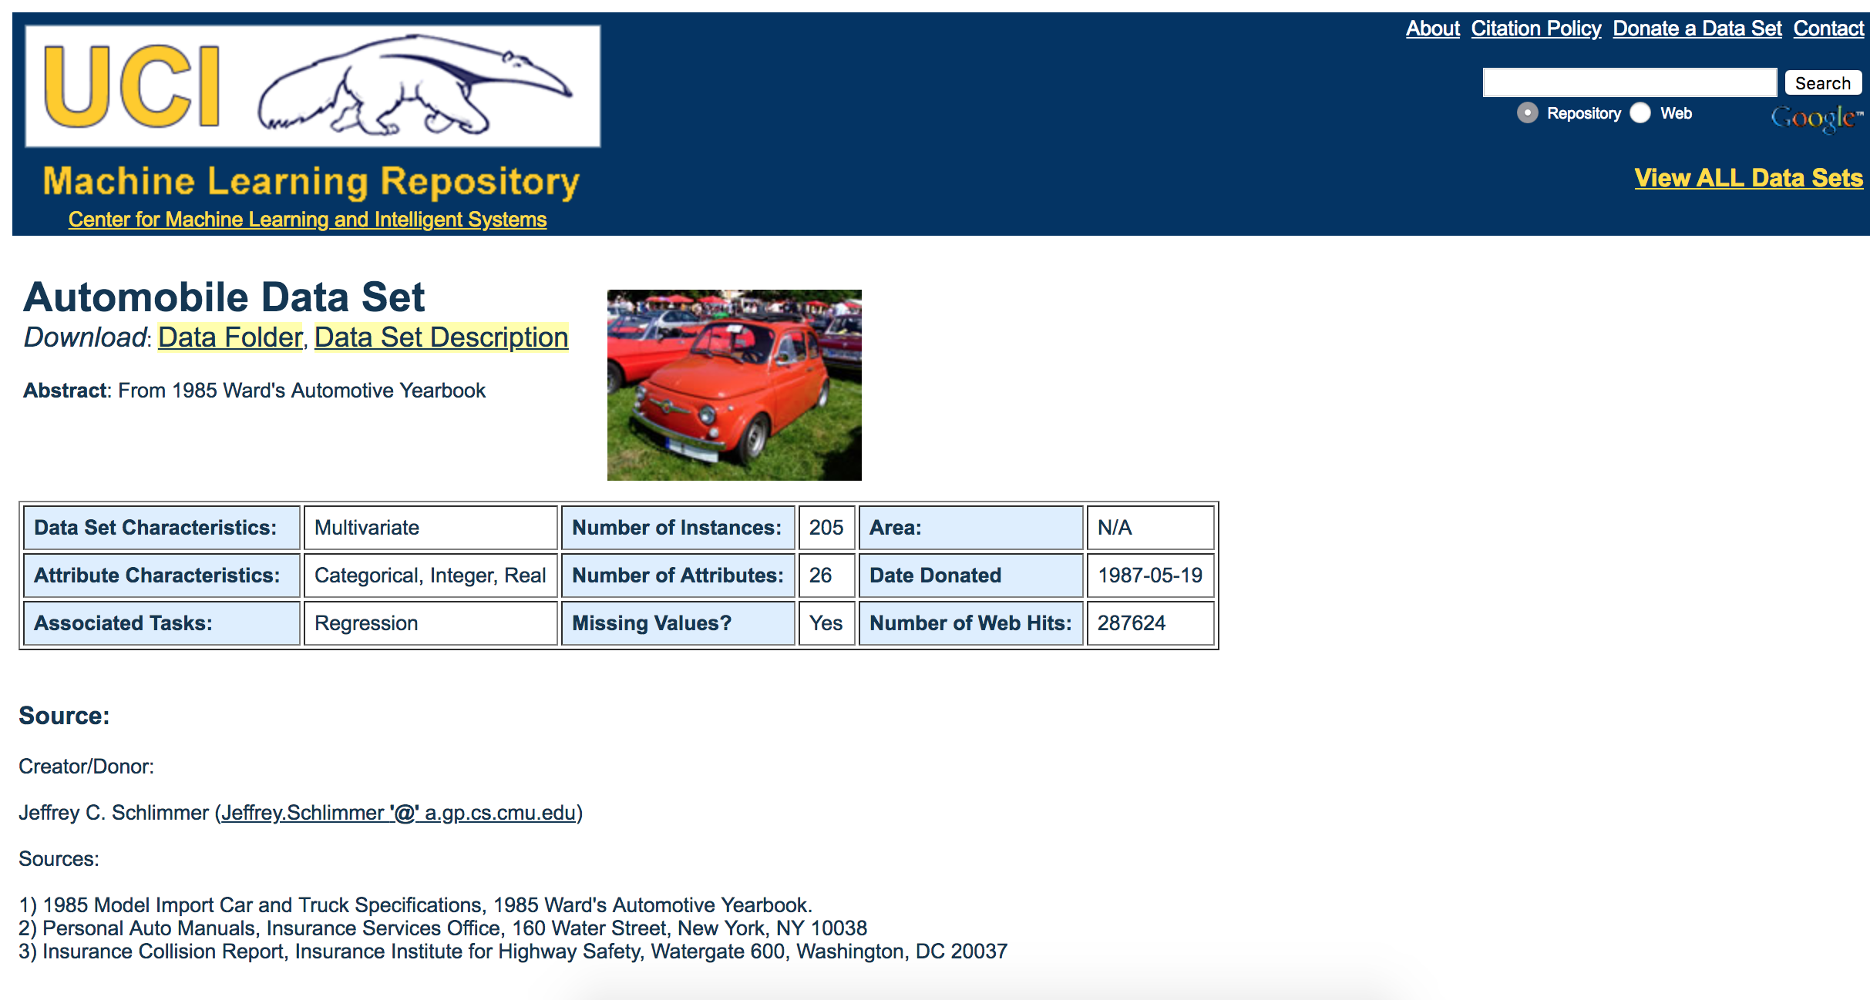
Original Data Resources
https://archive.ics.uci.edu/ml/datasets/Automobile
Original Data
Number of Variables: 26
Number of Observations: 205
Missing Data: Yes
Year: 1987

Slide 6
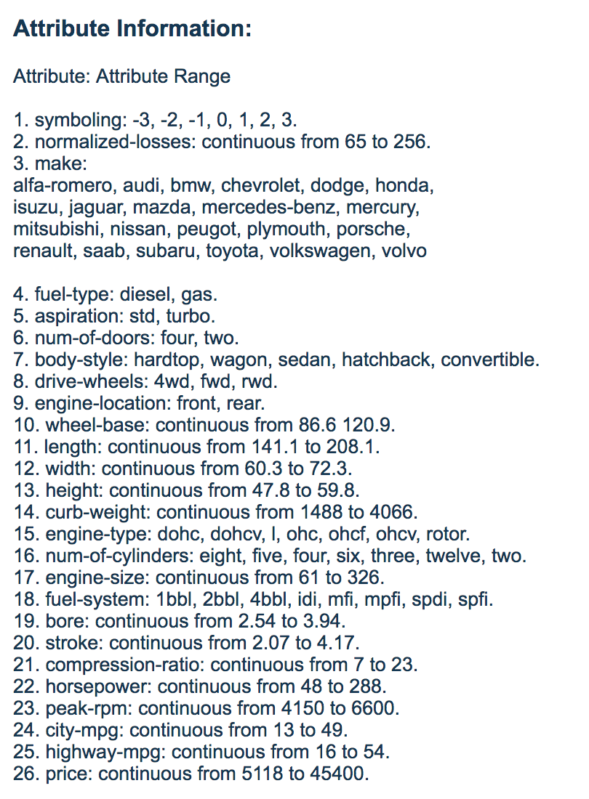
How the data is constructed?
Data regarding the paid losses are provided by the Insurance Collision Report by Insurance Institute for Highway Safety
Data regarding the characteristics (such as engine power, height ,curb weight) of the automobiles are provided by the 1985 Ward’s Automotive Yearbook

Slide 7
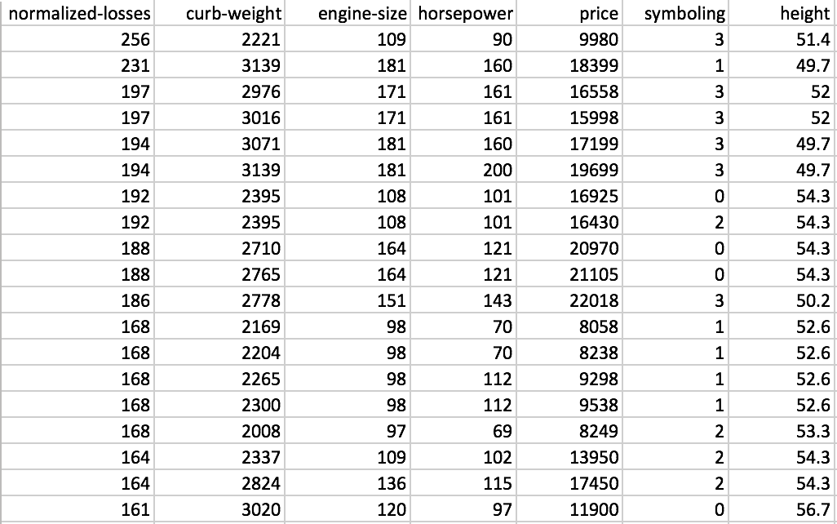
Data
Presentation of some data:
Y: Normalized Losses
X1: Curb Weight
X2: Engine Size
X3: Horsepower
X4: Price
X5: Symboling
X6: Height

Slide 8
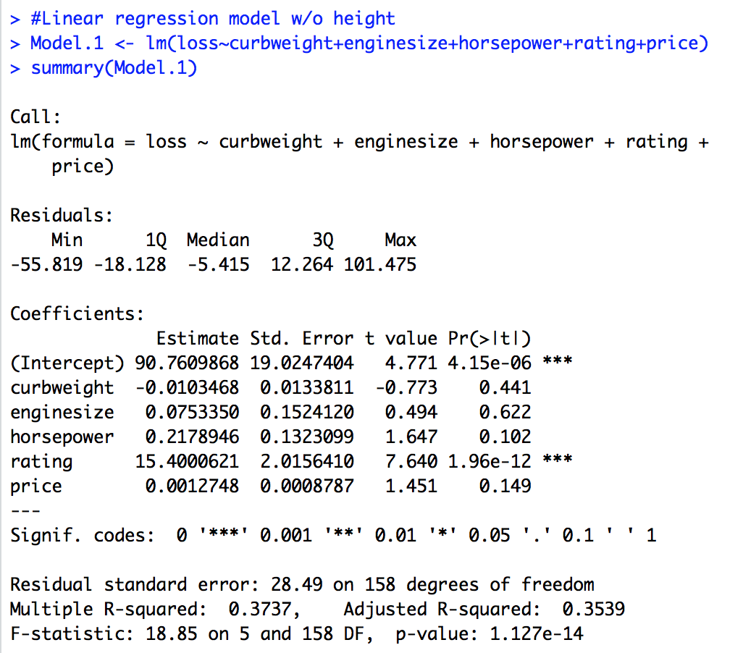
Variable Selections
Intuition
Automatic Variable Selection procedure: With highest R-squared, Correlation coefficient

Slide 9
Definition of Dependent Variables
Y: Normalized Losses
Average loss payment per insured vehicle year.
This value is normalized for all autos within a particular size classification (two-door small, station wagons, sports/specialty, etc.)

Slide 10
Definitions of Explanatory Variables
X1: curb weight weight of an automobile without any occupants or baggages (lb)
X2: Engine size measured by displacement, expressed in liters (L)
X3: Horsepower the power of an engine measured in terms of 550 foot-pounds per second (745.7 watts)
X4: Price settle down price of the automobiles (dollar)

Slide 11
Definitions of Explanatory Variables
X5: Symboling This variable is a rating, which corresponds to the degree to which the auto is
more risky than its price indicates. Cars are initially assigned a risk factor symbol associated with its price. A value of +3 indicates that the auto is risky, -3 that it is
relatively safer.
X6: Height height of the automobiles (inch)

Slide 12
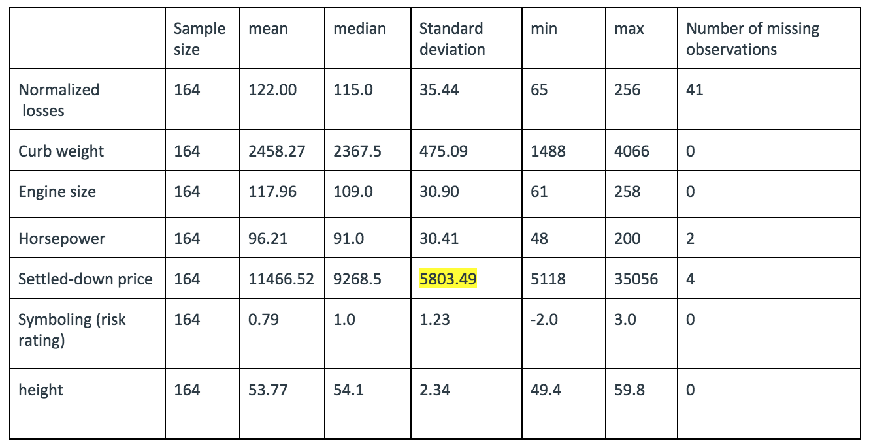
Summary Statistics

Slide 13
Results in steps
Correlation
Scatterplot Matrix
Residual Analysis
Check Multi-Collinearity
Fitting Different Models

Slide 14
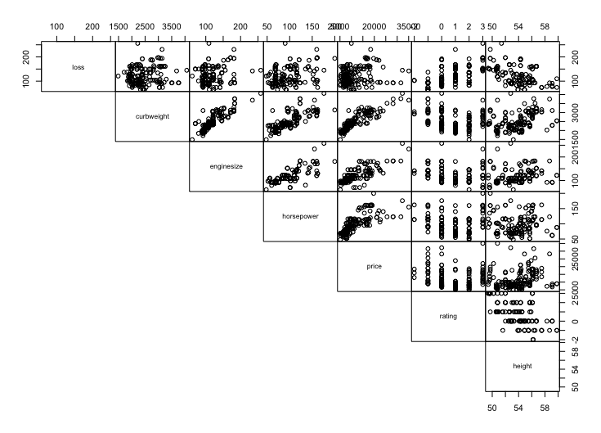
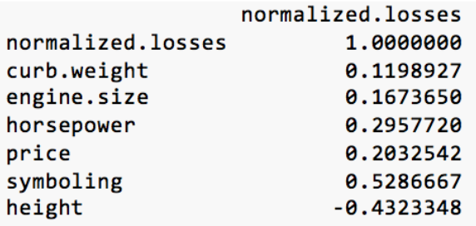
Summary Statistics

Slide 15


Models

Slide 16
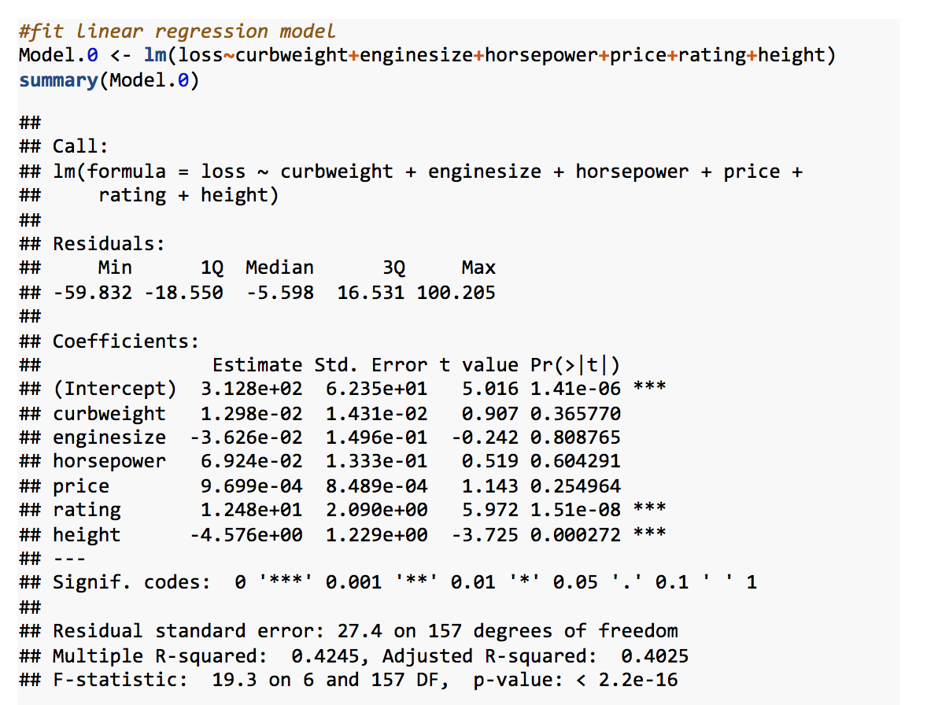
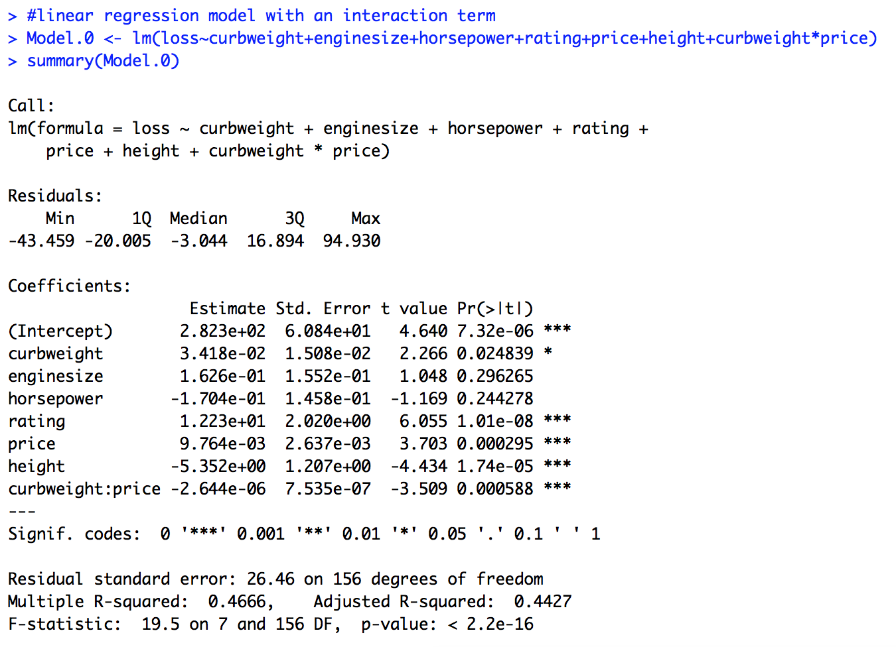
Model Comparison
Notes:
Indicates a moderate fit. 40.25% of the errors can be explained by the regression model.

Slide 17
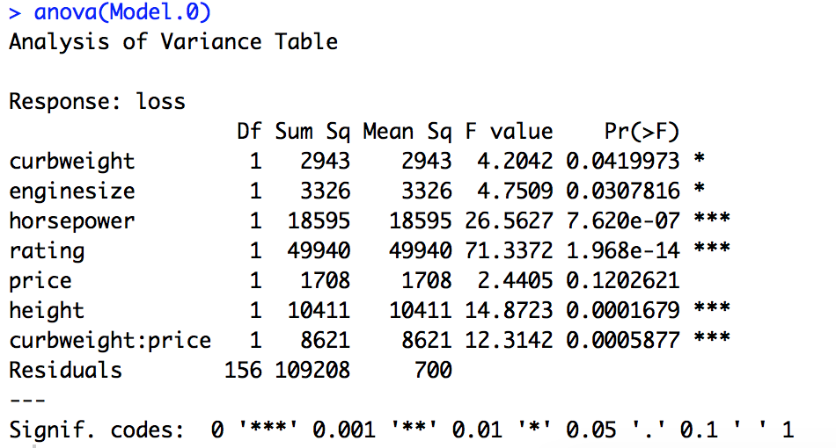
ANOVA Table

Slide 18
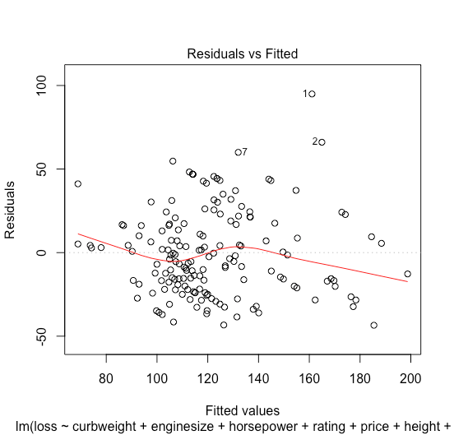
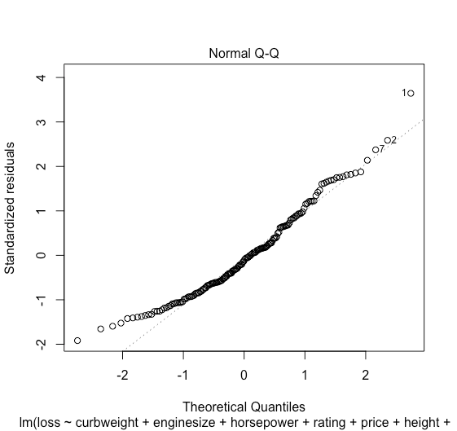
Plots

Slide 19
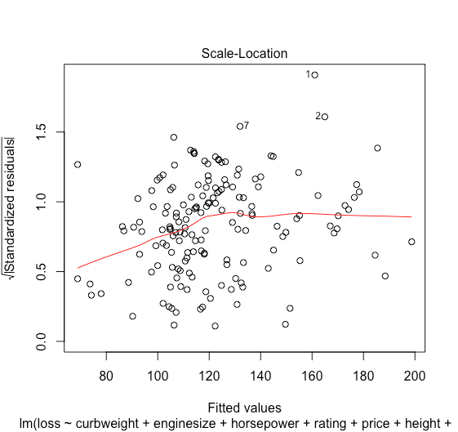
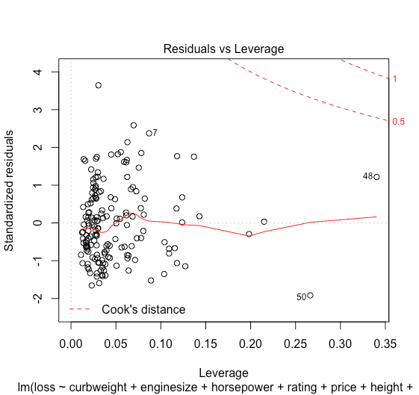
Plots
Notes:
The third plot is a scale-location plot (square rooted standardized residual vs. predicted value). This is useful for checking the assumption of homoscedasticity. In this particular plot we are checking to see if there is a pattern in the residuals.
The fourth plot is of "Cook's distance", which is a measure of the influence of each observation on the regression coefficients. The Cook's distance statistic is a measure, for each observation in turn, of the extent of change in model estimates when that particular observation is omitted.

Slide 20
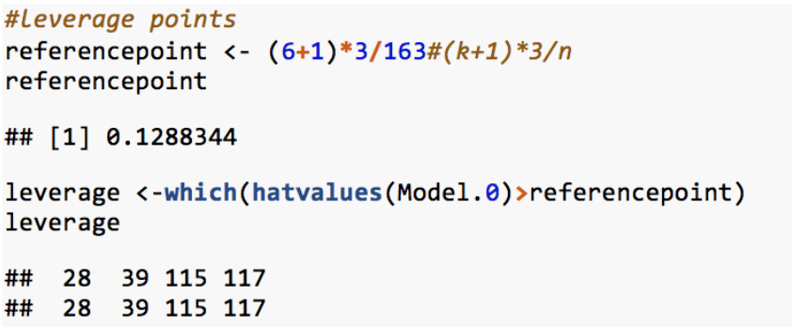
Leverage Points
We found four high leverage points with normalized losses: 28, 39, 115, 117, using the criterion of leverage points, which is hii > 3(k+1)/n.

Slide 21
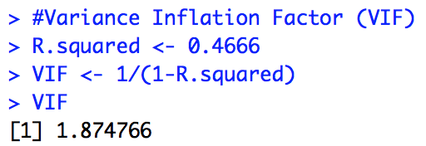
Check Multi-Collinearity
Notes:
1.87 percent change of Y can be explained by explanatory variables
Rule of Thumb : >= 10, then severe

Slide 22
Conclusion
Our research indicates that automobile paid losses(Y) fits a linear regression model with our explanatory variables moderately.
Height and risk rating are significant explanatory variables.
More significant variables should be included such as drivers’ information (ages, driving years, marital status, etc.), but they are not available in this dataset.
Another possible implication is that there is a better model to fit our data (such as a quadratic trend, etc.), and further research need to be conducted.

Slide 23
References
Duan, et al. (2018). A Logistic Regression Based Auto Insurance Rate-Making Model Designed for the Insurance Rate Reform, International Journal of Financial Studies
Original Data. Retrieved from: https://archive.ics.uci.edu/ml/datasets/Automobile
Xiao & Yu (n.d.). Retrieved from:http://alumni.soe.ucsc.edu/~sxiao/courses/ams225Report.pdf

Slide 24
Thank you for watching!

